Slide 1
Discrete Mathematics
Xiaowei Yang
South China University of Technology

Slide 2
Chapter 5. Relations
Relations and Their Properties
Section 5.1

Slide 3
Contents
1
Introduction
2
Function and Relations on A Set
3
Properties of Relations
4
Combining Relations

Slide 4
Introduction

Slide 5
Binary Relations
Let A, B be any sets. A binary relation R from A to B, (i.e., with signature R:A×B) can be identified with a subset of A×B.
  E.g., < can be seen as {(n,m) | n < m}
(a,b)∈R means that a is related to b (by R)
Also written as aRb; also R(a,b)
  E.g., a<b and < (a,b) both mean (a,b)∈ <
A binary relation R corresponds to a characteristic function P_{R}:A×B→{T,F}

Slide 6
Example 1
Let A be the set of students in your school.
Let B be the set of courses.
Let R be the relation that consists of the pairs (a, b) where a is a student enrolled in course b.
(Jason Goodfriend, CS518)
(Deborah Sherman, CS518)
(Deborah Sherman, CS510)

Slide 7
Example 2
Let A={ 0, 1, 2 } and B={ a, b }.
Then { (0,a),(0,b),(1,a),(2,b) } is a relation from A to B.
0 R a 1 R b

Slide 8
Inverse Relations
Any binary relation R:A×B has an inverse relation R⁻¹:B×A, defined by
R⁻¹ :≡ {(b,a) | (a,b)∈R}.
E.g., <⁻¹ = {(a,b) | a<b}⁻¹ = {(b,a) | b>a} = >.
E.g., if R:People x Foods is defined by
a R b ⇔ a eats b, then:
b R⁻¹ a ⇔ b is eaten by a. (Passive voice.)

Slide 9
Function and Relations on A Set

Slide 10
Functionality
A relation R: A×B is functional iff, for every a∈A, there is at most one b∈B such that (a,b)∈R.
Say this in predicate logic

Slide 11
Functionality
A relation R: A×B is functional iff, for every a∈A,
there is at most one b∈B such that (a,b)∈R.
∀a∈A: ¬∃ b_{1,}b₂ ∈B (b₁≠b₂ ∧ aRb₁ ∧ aRb₂).
If R is functional, then R can be seen as a function or a partial function R: A→B
(hence one can write R(a)=b as well as aRb,
R(a,b), and (a,b)∈ R. Each of these means the same.)
A functional relation R: A×B does not have to be total (i.e., there may be a∈A such that
¬∃b∈B (aRb)).

Slide 12
Functionality
Theorem: A relation R is a (total) function
R:A→B iff it is functional and total
(i.e., iff ∀a∈A: ∃b: aRb.)
Definition: R is anti-functional iff its inverse relation R⁻¹ is functional.
(Exercise: Show that iff R is functional and anti-functional, and both it and its inverse are total, then it is a bijective function.)

Slide 13
Relations on a Set
A (binary) relation from a set A to itself is called a relation on the set A.
E.g., the “<” relation from earlier was defined as a relation on the set N of natural numbers.
The next few slides: relations on a set A.

Slide 14
Relations on A Set
A relation on the set A is a relation from A to A.
Let A be the set { 1, 2, 3, 4 }.
R = { (a, b) | a divides b }
R = { (1, 1), (1, 2), (1, 3), (1, 4), (2, 2),
(2, 4), (3, 3), (4, 4) }

Slide 15
Example 3
R1 = { (a, b) | a ≤ b }
R2 = { (a, b) | a > b }
R3 = { (a, b) | a = b or a = -b }
R4 = { (a, b) | a = b }
R5 = { (a, b) | a = b + 1 }
R6 = { (a, b) | a + b ≤ 3}
(1,1) is in R1, R3, R4 and R6
(2,1) is in R2, R5 and R6

Slide 16
Properties of Relations

Slide 17
Reflexive
A relation R on a set A is called reflexive if (a, a) ∈R for every element a ∈A .
A = { 1, 2, 3, 4 }
R1 = {(1,1),(1,2),(2,1),(2,2),(3,4),(4,1),(4,4)}
R2 = {(1,1),(1,2),(2,1)}
R3 = {(1,1),(1,2),(1,4),(2,1),(2,2),(3,3),
(4,1),(4,4)}
R3 is reflexive, but others are not.

Slide 18
Reflexive
R1 = { (a, b) | a ≤ b }
R2 = { (a, b) | a > b }
R3 = { (a, b) | a = b or a = -b }
R4 = { (a, b) | a = b }
R5 = { (a, b) | a = b + 1 }
R6 = { (a, b) | a + b ≤ 3}
R1,R3 and R4 are reflexive.

Slide 19
Reflexivity and relatives
A relation R on A is reflexive iff ∀a∈A(aRa).
  E.g., the relation ≥ :≡ {(a,b) | a≥b} is reflexive.
  “divides” is reflexive since a|a holds.
R is irreflexive iff ∀a∈A(¬aRa)
Note “irreflexive” does NOT mean “not reflexive”, which is just ¬∀a∈A(aRa).
E.g., if Adore={(j,m),(b,m),(m,b),(j,j)} then this relation is neither reflexive nor irreflexive

Slide 20
Reflexivity and relatives
Theorem: A relation R is irreflexive iff its complementary relation R is reflexive.
  Example: < is irreflexive; ≥ is reflexive.
  Proof: trivial
Can you think of
  Reflexive relations
  Irreflexive relations
Involving numbers, propositions or sets?

Slide 21
Some examples
Reflexive:
  =, `have same cardinality’, ⇔
  <=, >=, ⊆, etc.
Irreflexive:
  <, >, `have different cardinality’, ⊂

Slide 22
Symmetric
A relation R on a set A is called symmetric if (b,a) ∈R whenever (a,b) ∈R, for all a,b ∈A.
A relation R on a set A such that (a,b) ∈R and (b,a) ∈R only if a=b for all a,b ∈A, is called antisymmetric.
“divides” is antisymmetric, for if positive integers a, b with a|b and b|a, then a=b.

Slide 23
Symmetric
R1 ={ (1,1),(1,2),(2,1),(2,2),(3,4),(4,1),(4,4)}
R2 = {(1,1),(1,2),(2,1)}
R3 = {(1,1),(1,2),(1,4),(2,1),(2,2),(3,3),
(4,1),(4,4)}
R4 = {(2,1),(3,1),(3,2),(4,1),(4,2),(4,3)}
R2 and R3 are symmetric.
R4 is antisymmetric.

Slide 24
Symmetric
R1 = { (a, b) | a ≤ b }
R2 = { (a, b) | a > b }
R3 = { (a, b) | a = b or a = -b }
R4 = { (a, b) | a = b }
R5 = { (a, b) | a = b + 1 }
R6 = { (a, b) | a + b ≤ 3}
R3, R4 and R6 are symmetric.
R1, R4 are antisymmetric.

Slide 25
Antisymmetry
Consider the relation x≤y
Is it symmetrical? No
Is it asymmetrical? No
Is it reflexive? Yes
Is it irreflexive? No

Slide 26
Antisymmetry
Consider the relation x≤y
  It is not symmetric. (For instance,
  5≤6 but not 6≤5)
  The pattern: when (a,b)∈ ≤
  and (b,a)∈ ≤ are when a=b
This is called antisymmetry
Can you say this in predicate logic?

Slide 27
Antisymmetry
A binary relation R on A is antisymmetric iff
∀a,b((a,b)∈R ∧ (b,a)∈R)→ a=b).
Examples: ≤, ≥, ⊆
How would you define transitivity of a relation? What are its ‘relatives’?

Slide 28
Transitive
A relation R on a set A is called transitive if whenever (a,b) ∈R and (b,c) ∈R, then (a,c) ∈R, for all a,b,c ∈R.
R0 = {(2,1),(3,1),(3,2),(4,1),(4,2),(4,3)}
R0 is transitive.
“divides” is transitive since a|b and b|c then a|c.

Slide 29
Transitive
R1 = { (a, b) | a ≤ b }
R2 = { (a, b) | a > b }
R3 = { (a, b) | a = b or a = -b }
R4 = { (a, b) | a = b }
R5 = { (a, b) | a = b + 1 }
R6 = { (a, b) | a + b ≤ 3}
R1,R2,R3 and R4 are transitive.

Slide 30
Transitivity & relatives
A relation R is transitive iff (for all a,b,c)
((a,b)∈R ∧ (b,c)∈R) → (a,c)∈R.
A relation is nontransitive iff it is not transitive.
A relation R is intransitive iff (for all a,b,c)
((a,b)∈R ∧ (b,c)∈R) → ¬(a,c)∈R.

Slide 31
Transitivity & relatives
What about these examples:
  “x is an ancestor of y”
  “x likes y”
  “x is located within 1 mile of y”
  “x +1 =y”
  “x beat y in the tournament”
  “x is stronger than y”

Slide 32
Transitivity & relatives
What about these examples:
  “is an ancestor of” is transitive.
  “likes” is neither trans nor intrans.
  “is located within 1 mile of”
  is neither trans nor intrans
  “x +1 =y” is intransitive
  “x beat y in the tournament” is neither trans nor intrans
  “x is stronger than y” is transitive.

Slide 33
Combining Relations

Slide 34
Composite Relations
Let R:A×B, and S:B×C. Then the composite S□R of R and S is defined as:
S□R = {(a,c) | ∃b: aRb ∧ bSc}
Does this remind you of something?

Slide 35
Composite Relations
Let R:A×B, and S:B×C. Then the composite S□R of R and S is defined as:
S□R = {(a,c) | ∃b: aRb ∧ bSc}
Does this remind you of something?
Function composition ...
... except that S□R accommodates the fact
that S and R may not be functional

Slide 36
Composite Relations
Let R:A×B, and S:B×C. Then the composite S□R of R and S is defined as:
S□R = {(a,c) | ∃b: aRb ∧ bSc}
Function composition is a special case of relation composition: Suppose S and R are functional. Then we have (using the definition above, then switching to function notation)
S□R(a,c) iff ∃b: aRb ∧ bSc
iff R(a)=b and S(b)=c iff S(R(a))=c

Slide 37
Example
R = {(1,1),(1,4),(2,3),(3,1),(3,4)}
S = {(1,0),(2,0),(3,1),(3,2),(4,1)}
S□R = {(1,0),(1,1),(2,1),(2,2),(3,0),(3,1)}
R={(1,1),(2,1),(3,2),(4,3)}
R^2 = R □ R ={(1,1),(2,1),(3,1),(4,2)}
R^3 = R □ R □ R ={(1,1),(2,1),(3,1),(4,1)}
R^n = R □ R □ R ={(1,1),(2,1),(3,1),(4,1)}
n≥3

Slide 38
Theorem 1
The relation R on a set A is transitive if and only if R^n ⊆ R for n = 1,2,3…
Proof.
(a,b) ∈R and (b,c) ∈R then (a,c) ∈R^2
and (a,c) ∈R.
…… Use mathematical induction

Slide 39
Composite Relations
Let’s see what happens when we compose R with itself
Exercise: Prove that R:A×A is transitive iff R□R = R.

Slide 40
Composite relations
The n^{th} power R^{n} of a relation R on a set A
  The 1st power of R is R itself
  The 2nd power of R is R² = R□R
  The 3rd power of R is R³= R□R□R
etc.

Slide 41
Composite Relations
The n^{th} power R^{n} of a relation R on a set A can be defined recursively by:
R¹ :≡ R ; R^{n+1} :≡ R^{n}□R for all n≥1.
E.g., R² = R□R; R³= R□R□R
e
d
a
c
b

Slide 42
Composite Relations
R²= R□R = {(a,c),(b,d),(c,c),(d,d)}
a: c d: d
b: d e: -
c: c
e
d
a
c
b

Slide 43
Applications

Slide 44
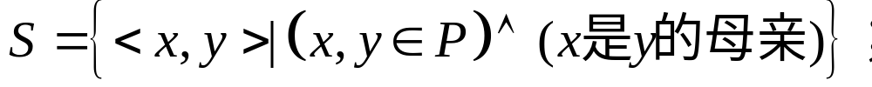

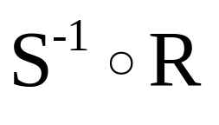
Application
设R和S定义在P上的二元关系，P是所有人的集合
（1） 表示的是什么关系。
（2） 表示的是什么关系。

Slide 45
Application
（1） 表示的是什么关系。
（2） 表示的是什么关系。

Slide 46
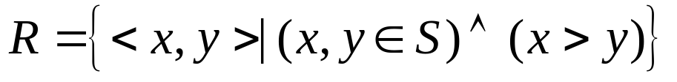
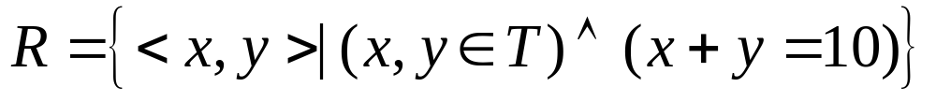
Application
2. 下列关系具有哪些性质？
（1）S上的关系
（2）T={1,2,3…,10}上的关系

Slide 47
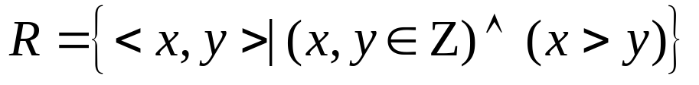
Application
2. 下列关系具有哪些性质？
（1）Z上的关系
R是反对称的，反自反的，传递的。
（2）T={1,2,3…,10}上的关系
R是对称的。

Slide 48

Application
3. 设R,S 是集合A上的关系，试证明或否定以下断言。
（1）设R,S是自反的，则 是自反的。
（2）若R,S是传递的，则 是传递的。

Slide 49

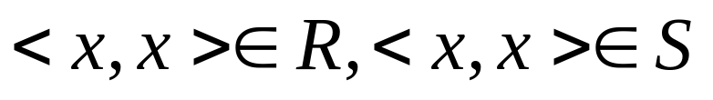
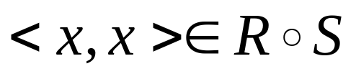
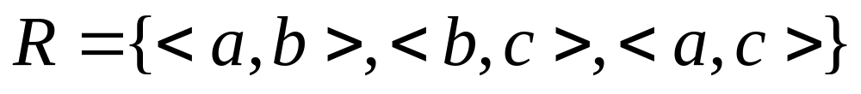
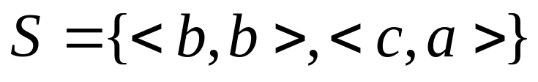

Application
（1）设R,S是自反的，则 是自反的。
正确。对任意 ,因为R,S是自反的，所以 。由关系映射关系则有 ，所以 是自反的。
（2）若R,S是传递的，则 是传递的。
不一定。如 ，
都是传递的，但
不是传递的。

Slide 50
End of Section 5.1
Click to edit company slogan .

